Slide 1
Celery Architecture
(because onions make you cry)
A Primer on Vertical Slicing

Slide 2




About Garo Yeriazarian
SOFTWARE WHISPERER
~16 years in the business (more or less)
Helping people solve problems
MANAGER, LEADER, FUNGI
Spreading mirth and merriment and software
Resolving conflict, finding a better way
HOUSTONIAN
BS CS and MBA from University of Houston
Involved with various software communities
@garoyeri
https://headspring.com/author/garabed-yeriazarian/
Icons made by www.flaticon.com/authors/freepik Freepik from www.flaticon.com
Icons made by www.flaticon.com/authors/dave-gandy from www.flaticon.com

Slide 3

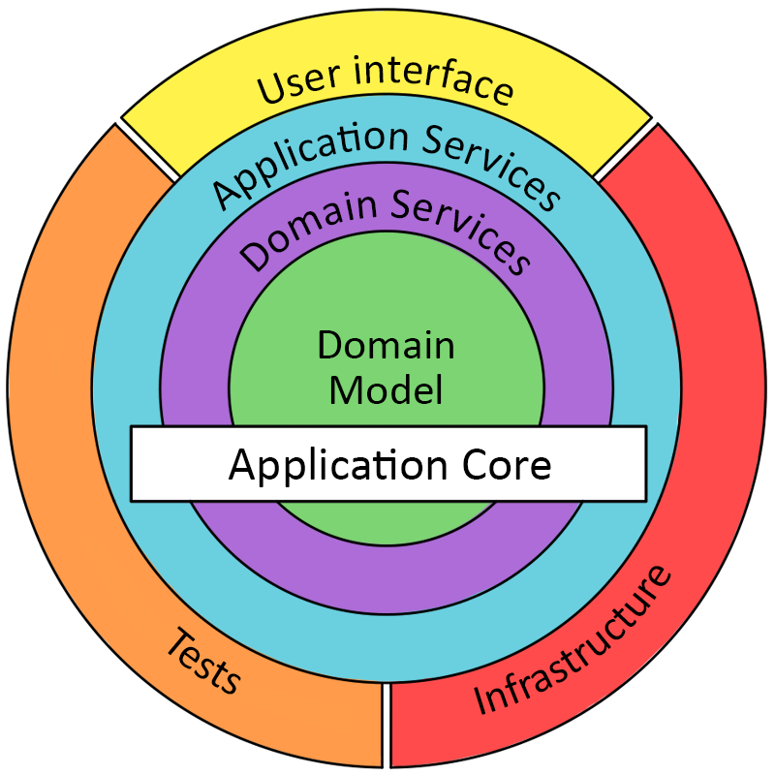
What is Onion Architecture?
https://dzone.com/articles/onion-architecture-is-interesting https://jeffreypalermo.com/2008/07/the-onion-architecture-part-1/
© User:Colin / Wikimedia Commons https://commons.wikimedia.org/wiki/File:Onion_on_White.JPG
Notes:
The basic theory of Onion is that you have layers where each outside layers reaches down to the layer below, but no further. Similarly, the inner layers don’t reach up, creating a solid separation of concerns.
However, this model tends to introduce bad behaviors for organizations (team for each layer or concern)
When working in agile processes, causes blockage between teams

Slide 4
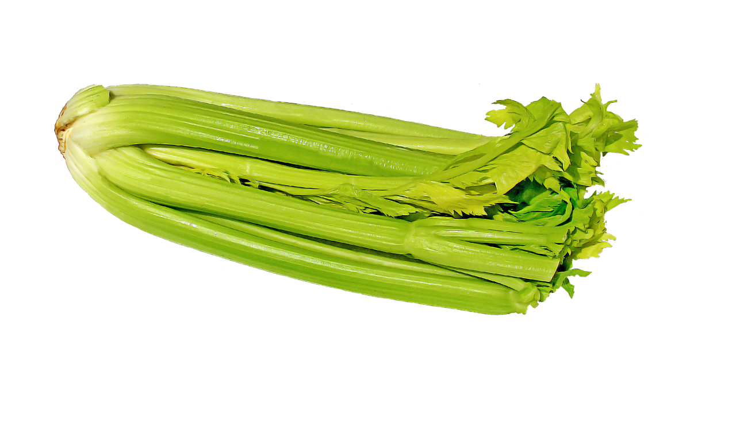
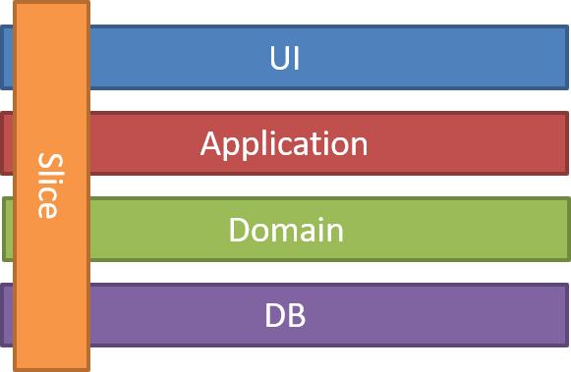
What is Celery Architecture?
https://jimmybogard.com/vertical-slice-architecture/ https://www.needpix.com/photo/344249/celery-vegetables-vegetable-green-free-pictures-free-photos-free-images-royalty-free

Slide 5
Anatomy of a Request
ASP.NET Core Route
Begin Transaction
Controller Action
MediatR Pub / Sub
Return Action Result
Commit Transaction
Exception Handler
Rollback Transaction
HTTP Request
React Route
Render
Component

Slide 6
Example Request
ASP.NET Core Route
Begin Transaction
TodoController.Add()
AddItem.
Handler.
Handle()
Return new TodoItem
Commit Transaction
Exception Handler
Rollback Transaction
POST /api/Todo
React Route
Render
Component

Slide 7

Demo Time
(cross your fingers)
https://www.svgrepo.com/svg/154319/celery

Slide 8
Open Source Libraries
ASP.NET Core
Entity Framework Core
MediatR
AutoMapper
NSwag, SwaggerUI, ReDoc
Fixie
React
Jest
Shouldly

Slide 9
Why Celery Architecture?
JUST ENOUGH ARCHITECTURE
Build just enough architecture for your application
The code you don’t write has no bugs
CODE ORGANIZATION
Feature work requires little context switching
Happier pull-requests (all related work is together)
EASY TO SWAP OUT FEATURES
When changing implementations, just change Handler
USE FEATURES DURING TESTING
When unit testing, use the full features, not mocks

Slide 10
Other Useful Links
JIMMY BOGARD: VERTICAL SLICE ARCHITECTURE
https://jimmybogard.com/vertical-slice-architecture/
JIMMY BOGARD: CONTOSO UNIVERSITY CORE
https://github.com/jbogard/ContosoUniversityDotNetCore
USE THE REACT PROJECT TEMPLATE WITH ASP.NET CORE
https://docs.microsoft.com/en-us/aspnet/core/client-side/spa/react
MEDIATR
https://github.com/jbogard/MediatR
AUTOMAPPER
https://automapper.org/
THIS DEMO IN GITHUB
https://github.com/garoyeri/celery-architecture-demo

Slide 11
Questions
Comments
Queries
Concerns?

